Slide 1


Private and Confidential 27 April 2022
www.roborn.com
COPYRIGHT 2020 © ROBORN. ALL RIGHTS RESERVED.

Slide 2
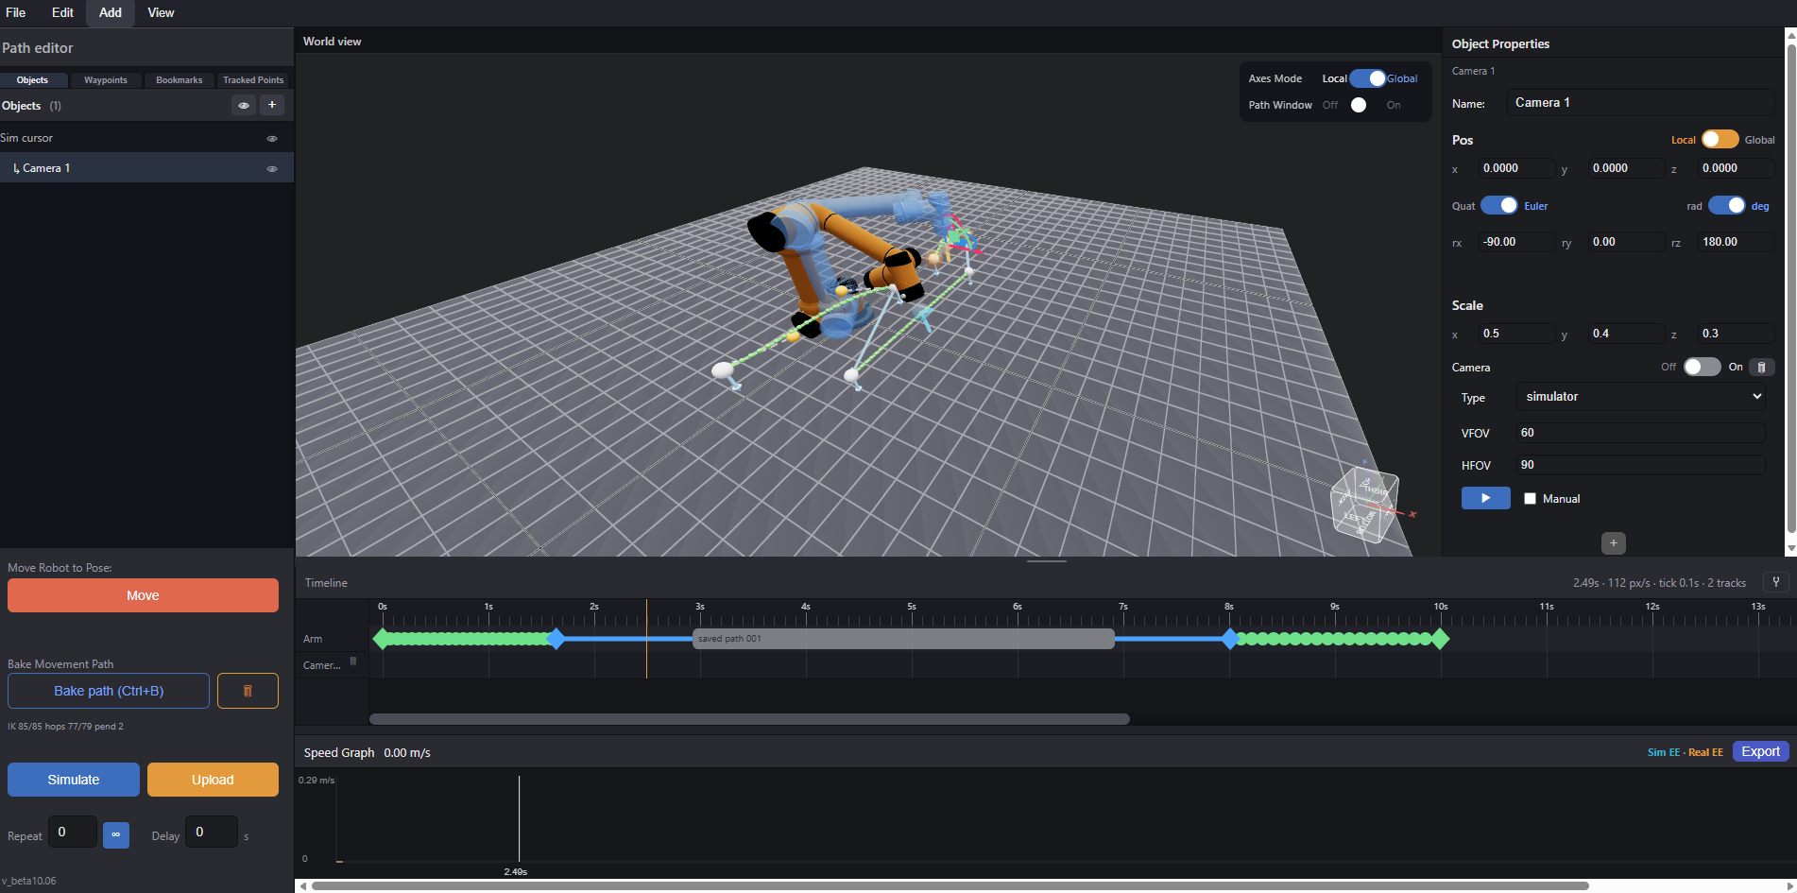
Overview
Main View
List of Elements
Object Properties
Timeline
Control Panel
Speed Graph

Slide 3
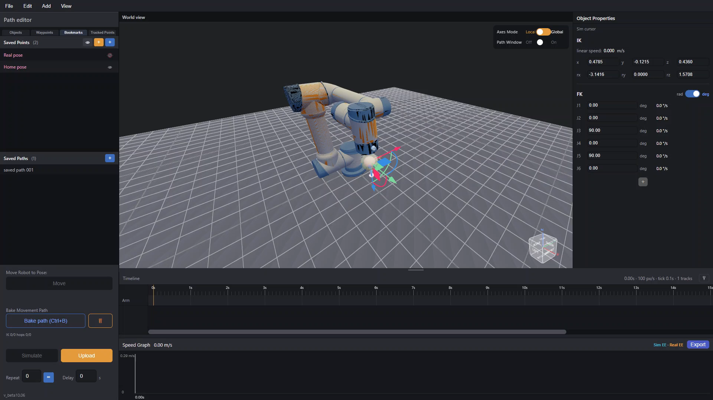
Basic Controls
Taken from any simulator out there
Should be added to video shoot UI
Drag in 3D space (left click) to rotate view, right click drag to move around
- Simply select the simulation robot’s EE controller (simbot cursor) to render transform axes gizmo
Drag the axes to move and rotate robot pose
IK is calculated in real time, if IK fails, robot freezes until it can solve the IK again
Axes mode can be switched to fit world axes for positional changes and local axes for changes relative to EE pose

Slide 4
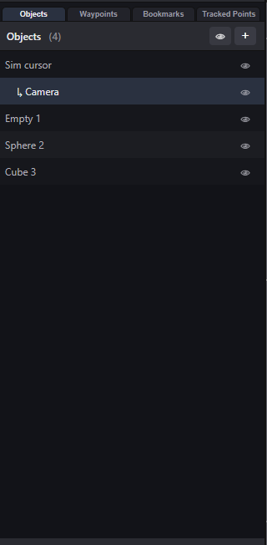
List of Elements
Tabs
Number of Items
Item
Shows list of all the elements present in the scene,
including:
Waypoints
Bookmarked positions
3D objects
Users can add these elements in the appropriate tab
with the “+” button and toggle visibility with “eye” button
Toggle Visibility (All)
Toggle Visibility (Single)

Slide 5
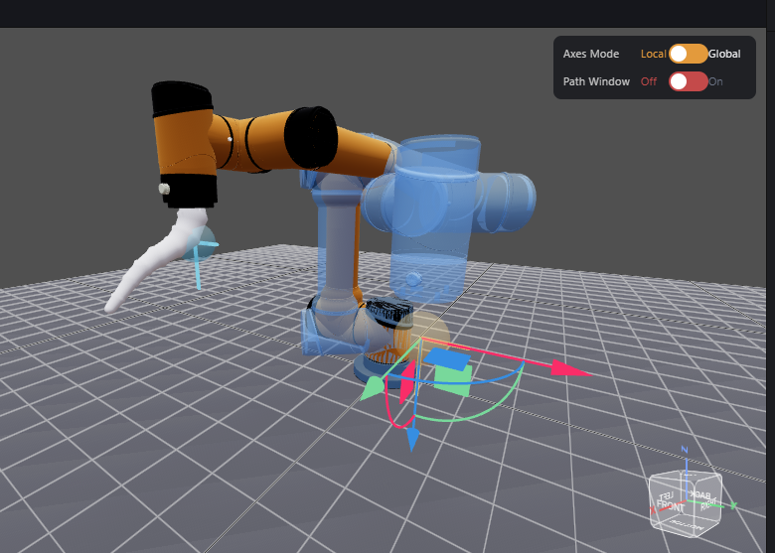
List of Elements: Objects List
Taken from Unity
Should NOT be added to video shoot UI
Shows and Adds 3d objects to scene
Sim bot is displayed as “sim cursor”
Users can add additional simple or even custom .stl
3D objects to simulate environment
Users can even add advanced objects like cameras to
simulate camera position in sim world
Parent Hierarchy System:
  Users can parent objects such that they move together with their parent:
    Useful for binding objects to EE, eg. EE bound cameras
Imported .stl object bound to robot EE

Slide 6
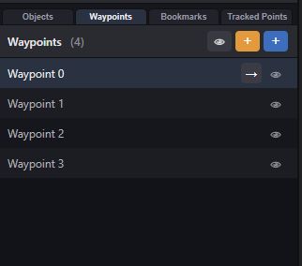
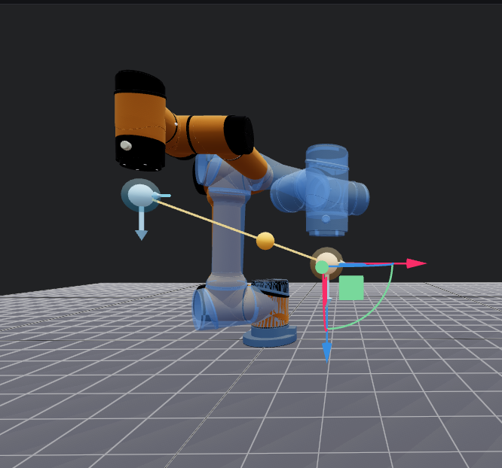
List of Elements: Waypoints
Should be added to video shoot UI
- Lists and adds waypoints (points used to create robot motion path)
in 3D sim space
Orange to add point from real robot pose
  Ideal for hand drag path planning
Blue to add point from sim bot pose
  Ideal for simulation dragging poses
No true hand drag planning:
true hand drag requires recording every point per ms
->200+ points for simple path
-> minor mistake gets recorded easily
+ 200 points to modify ->infeasible to fine tune each point
- Solution: Bezier curve path design
Waypoint made from real pose
Waypoint made from sim pose

Slide 7
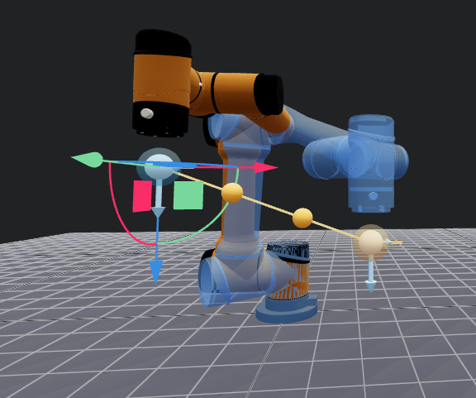
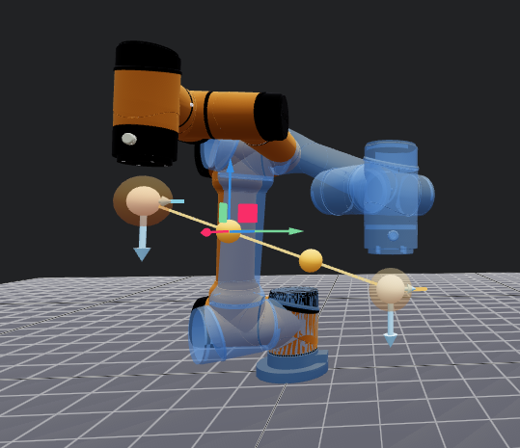
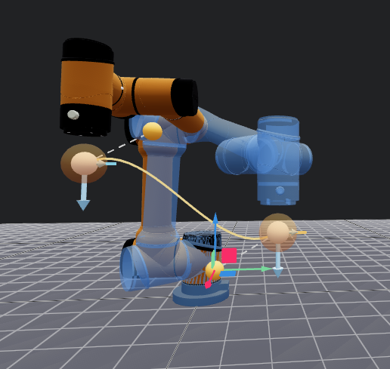
List of Elements: Waypoints
Should be added to video shoot UI
Click on waypoint to render dragging points
Click and drag the points to generate curve
Result: cleaner curves for motion paths that are easier to customise

Slide 8
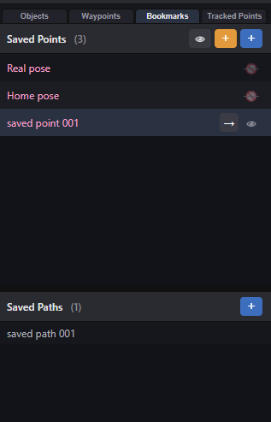
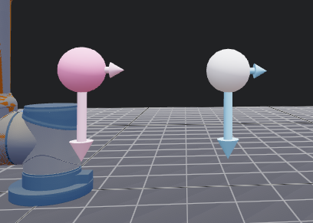
List of Elements: Bookmarks
Saved Points:
Lists and stores important poses to be used by sim bot
Add points with same logic as adding waypoints
Click arrow button to teleport sim bot to the specified pose
Important poses added by default include:
- Home pose (right angle pose)
- Real pose (real bot’s current pose)
Bookmarks can be saved either locally per project, or globally to be shared across multiple files
Right hand direction
Main direction
Saved Paths:
Stores and loads entire motion paths
(to be explained further later)
Saved point (Pink)
Waypoint (White)

Slide 9
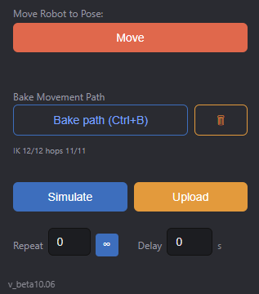
Control Panel
Move real robot to sim bot pose
(linear speed adjustable in settings)
Bake Path:
Generate sample points along the path in constant spacing (adjustable distance) to approximate path
Check if points are valid poses (IK check)
Check if points are valid speed (speed check)
Simulate path run after bake
Run path after bake
Set motion path to be repeatable (untested)
Non video shooting related

Slide 10
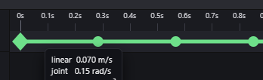


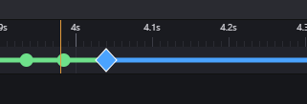
Path Baking
Should be added to video shoot UI
1. Generate Sample Points to approximate path
  Sample points are jotted by distance instead of time as the time frames are adjustable in the timeline post bake
2. To check if path has valid Iks
3. To Check if points are spaced and timed appropriately such that robot does not run over speed (Note: speed test seems to pass no matter what at the moment)
Any changes to timeline or waypoints position requires a full rebake
Bake States: white/Grey: Unbaked, Red: IK failed, Green: Everything OK, Blue: Force FK Mode (to be elaborated later), Orange: IK OK but speed too fast, Yellow: IK checked but not yet speed
Yellow state bugged
Waypoints passed bake
Waypoints failed bake
Waypoint passed bake
but is too fast
Waypoint using Force FK

Slide 11
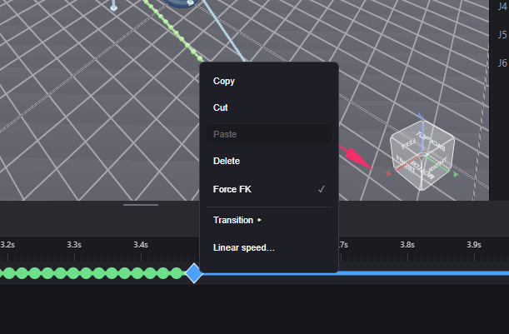
Path Baking: Force FK
For paths where final position is more important than the path shape itself, Or when waypoints are placed too complex and IK in between keeps failing,
user can set waypoint to “Force FK” mode such that the no sample points are created within the path segment -> direct moveJ between the 2 waypoints

Slide 12





Simulate and Play
Both states only run after a completely fine bake
Simulate
Simulate motion path in 3d world view
Pause available
Adjust timeline cursor to replay certain parts of path
Run
Upload path to robot first
Hold button to move robot to init pose
Run path
Pause not available, but interruptible

Slide 13
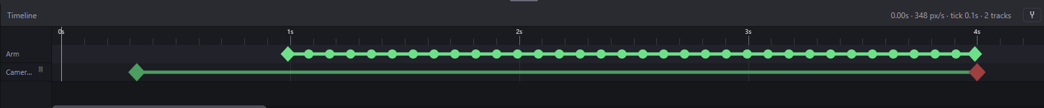
Timeline
Taken from animation software (ie Blender)
Should be added to video shoot UI
cursor
Arm track:
Diamond Frames: waypoints
circle frames: generated sample points
By default the sample points are equally spaced on generation (first bake), they can then be dragged to customise speed, rebake again to run speed check
Snap to grid toggle
(bugged, not working atm)
Camera track: (elaborated later)
Green Diamond: start record
Red Diamond: stop record
(note there is delay sending the command to sony camera)

Slide 14
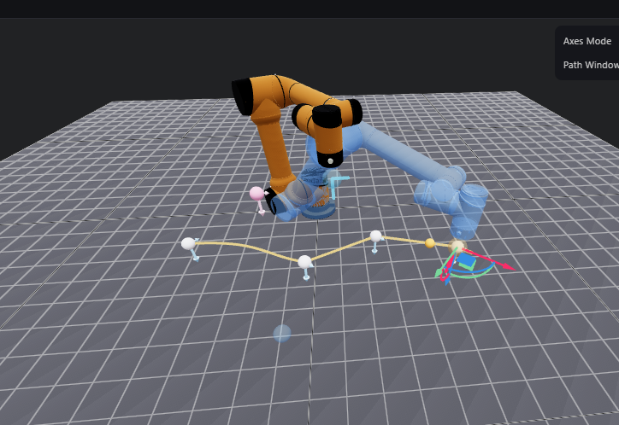
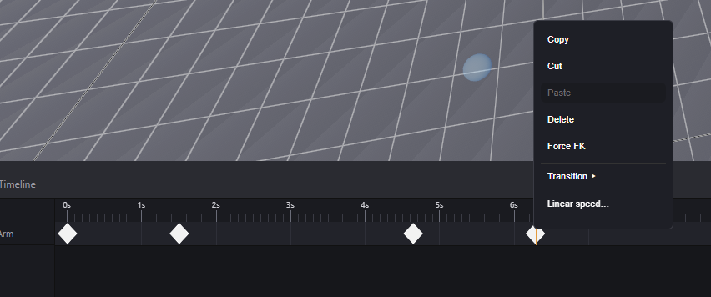
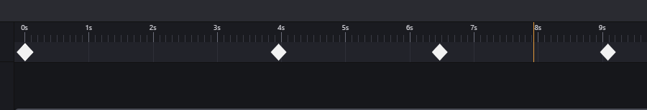
Timeline: Linear Speed
Path
Spaced by path distance
For irregular paths with constant linear speed, users can select the range of waypoints and use the “linear speed” option to set the path segments(s) to be run at the constant desired speed,
program calculates distance of path and approximates time required for robot to reach destination at given spee

Slide 15
Timeline: Transitions
Other than manually dragging each point by hand, user can use default transitions to set acceleration of path segments
Note: Transitions are spaced mathematically without regard of path distance and robot max speed
-> fast segments can go really fast, safety check WIP
custom drag
linear
Ease in
(slow -> fast)
Ease out
(fast -> slow)

Slide 16
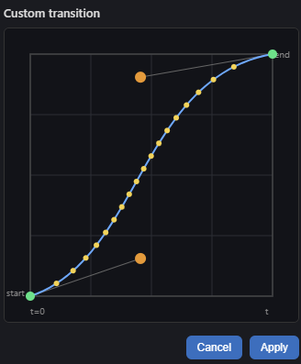
Timeline: Transitions
User can also customise transitions with Bezier curves, but feature is untested
End waypoint
Sample points
Start waypoint

Slide 17
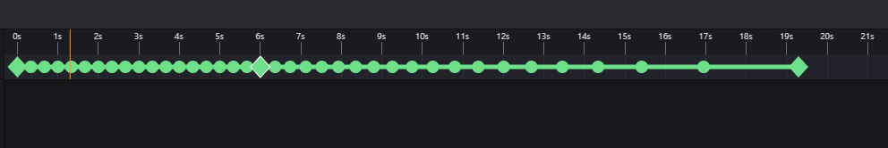
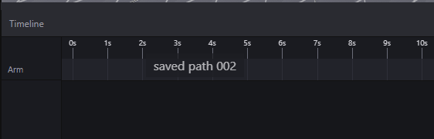
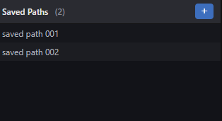
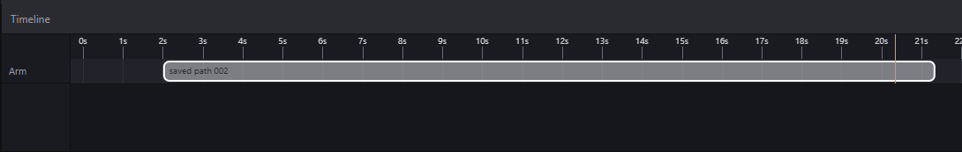
Saved Paths
Taken from Video Editing software (eg. Premiere Pro)
Users can save entire timeline into a block (saved path)
Like saved points they can be saved locally or globally
Users can drag saved paths onto timeline to reuse specific paths or simply use default given paths for simplicity (ie create paths via waypoint method and provide them as saved paths to be used in video shoot ui)
Save to
Load

Slide 18
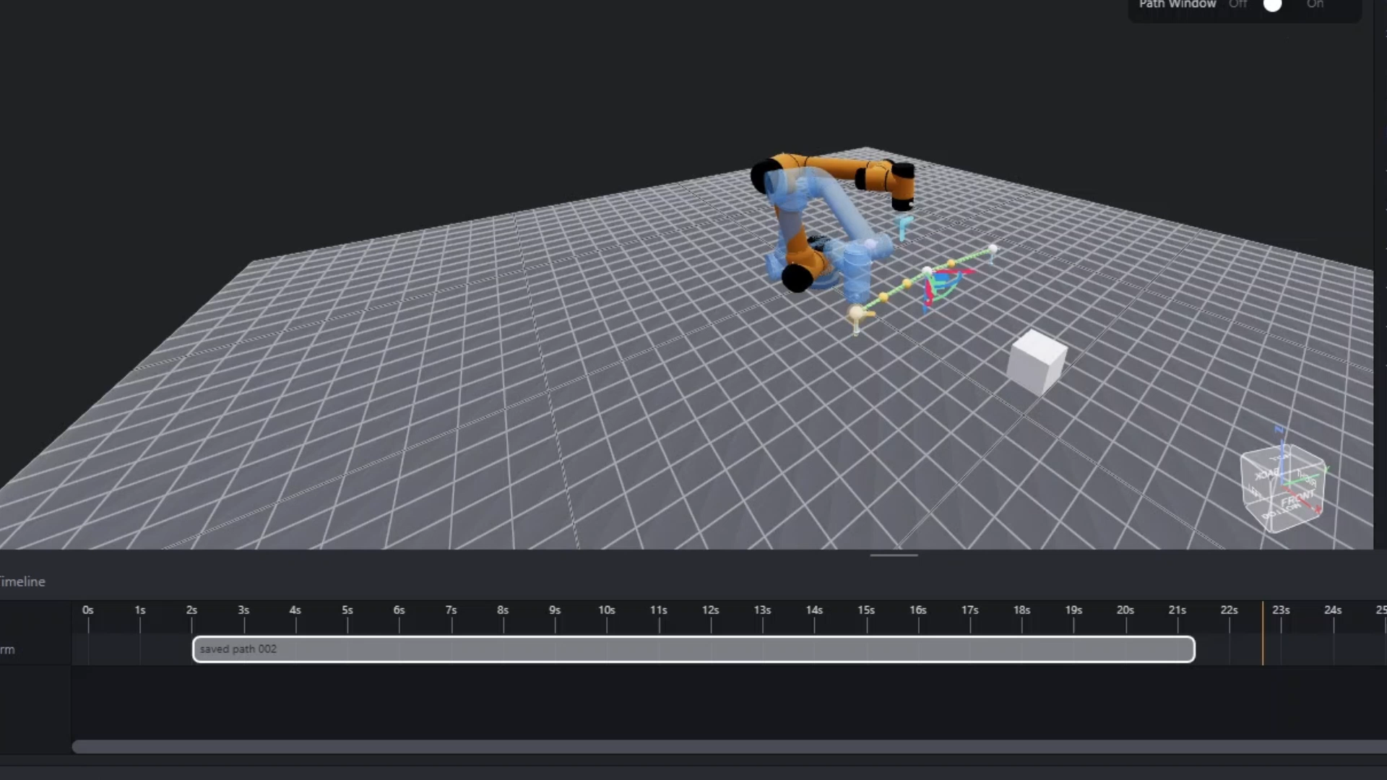
Saved Paths
Saved paths can be used in conjunction with regular waypoints
At the moment segments connected to paths are Force FK mode by default for simplicity (avoid path editing for inexperienced users that rely on saved paths)
Experienced users can unwrap saved paths back to individual waypoints for customised edits

Slide 19
Object Properties
Shows transform and other relevant properties for selected item in world view

Slide 20
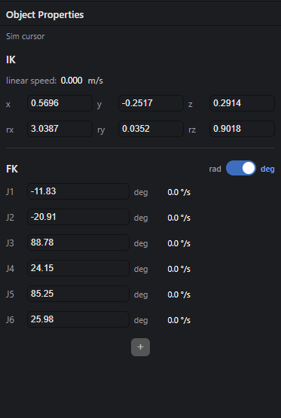
Object Properties: Cursors
Name
EE Position and Rotation
Joint Poses
Transforms are editable to control sim bot, but not real bot
Real cursor properties bugged atm
[placeholder image]

Slide 21
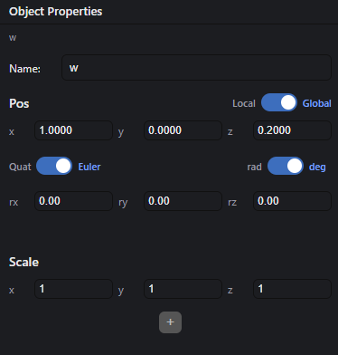
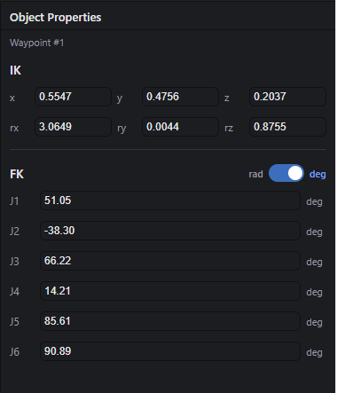
Object Properties: 3D Objects & Waypoints
3D Objects
Name
Position and Rotation in world or relative to parent (if exists)
Scale
Waypoints and Saved Points
Name
EE Position and Rotation to get to the point
Joint Poses
Transforms are editable to move waypoints, but not saved points

Slide 22
Object Properties: Components
Taken from Unity
Should NOT be added to video shoot UI
Add components to 3D objects to add functions/ modify their behaviour
Add a component

Slide 23
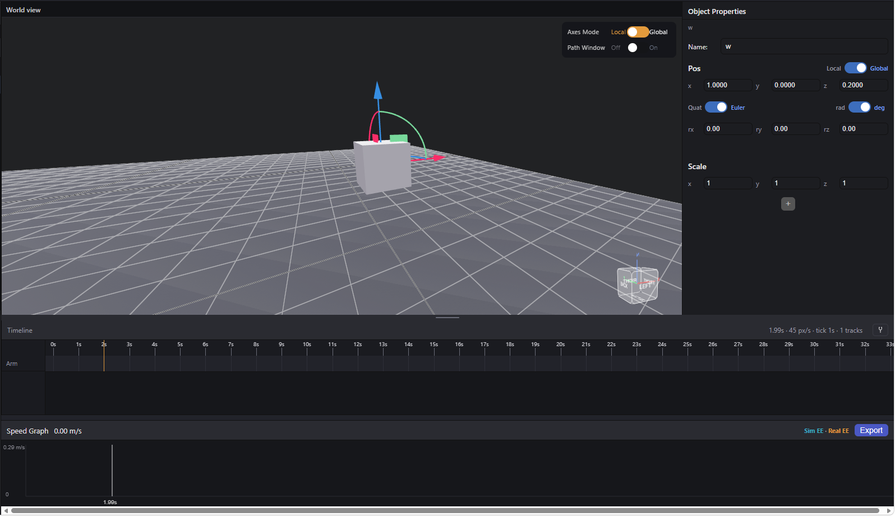
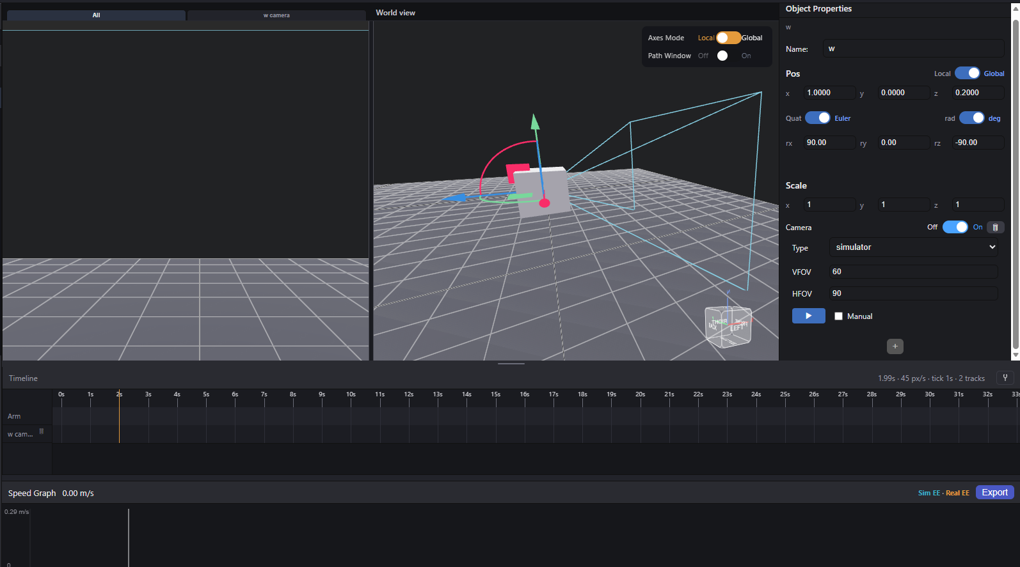
Component: Camera
Add camera component to turn 3d object into a camera object
Auto generate camera properties UI
Auto generate camera view
Auto generate camera track

Slide 24
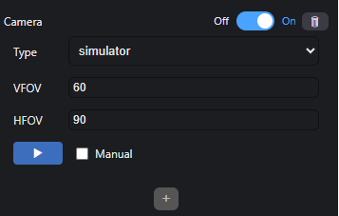
Component: Camera
3 camera types:
- sim: to preview camera in simulator, simulate video shoot in sim world with simulated 3d objects
- opencv: add custom python script for usb webcams for advanced tracking for other vision projects
- sony: utilise sony SDK to control real video shooting (very laggy with this program, use existing instead)
Control record keyframe of timeline
Start record
Stop record
Manual override toggle: record/stop disregarding timeline keyframes

Slide 25
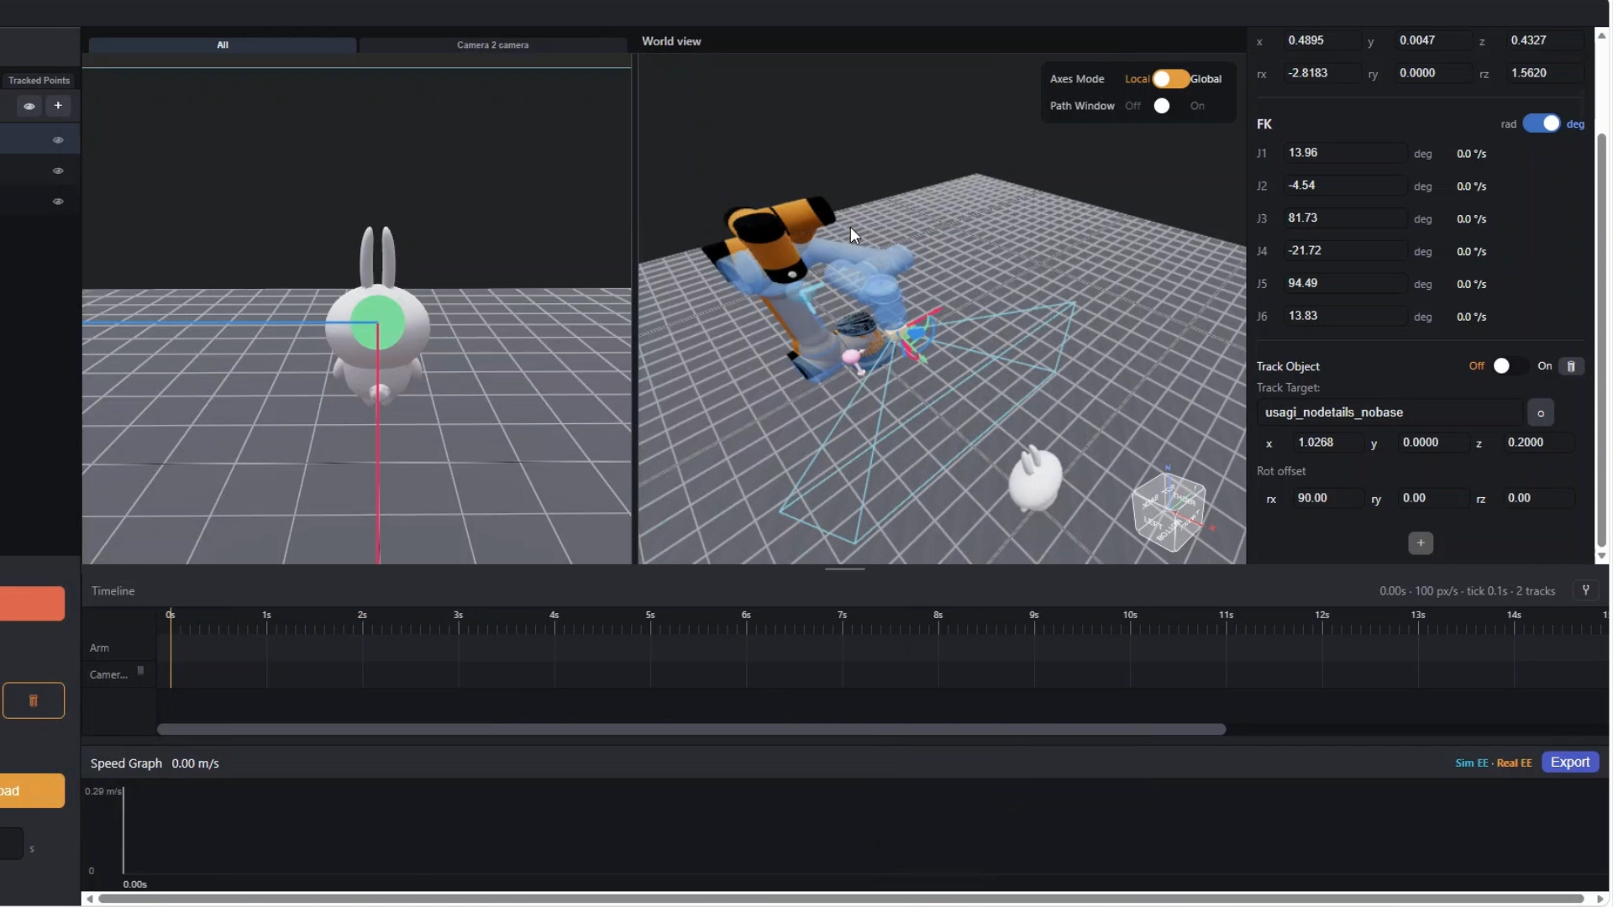
Component: Tracker
Given a target, the sim cursor looks at a designated object over drag and even along the path segments it generates
Together with opencv camera to do face tracking, arm can track and centre real targets as well as simulated objects (WIP)
Note: Current tracking tracks target position pre-bake, it does not track targets while running, live tracking WIP

Slide 26
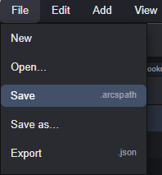
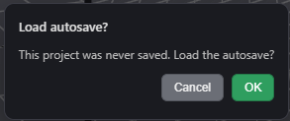
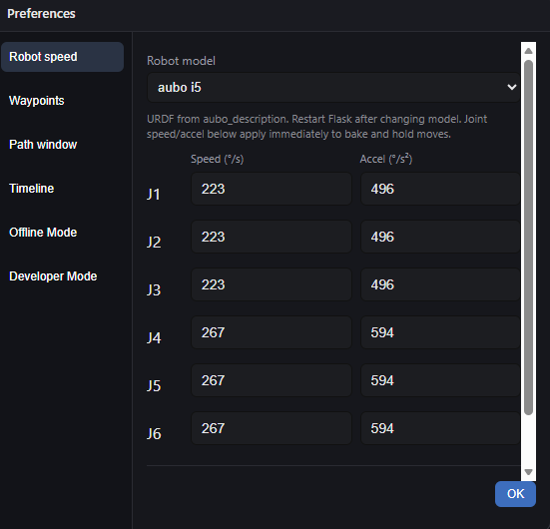
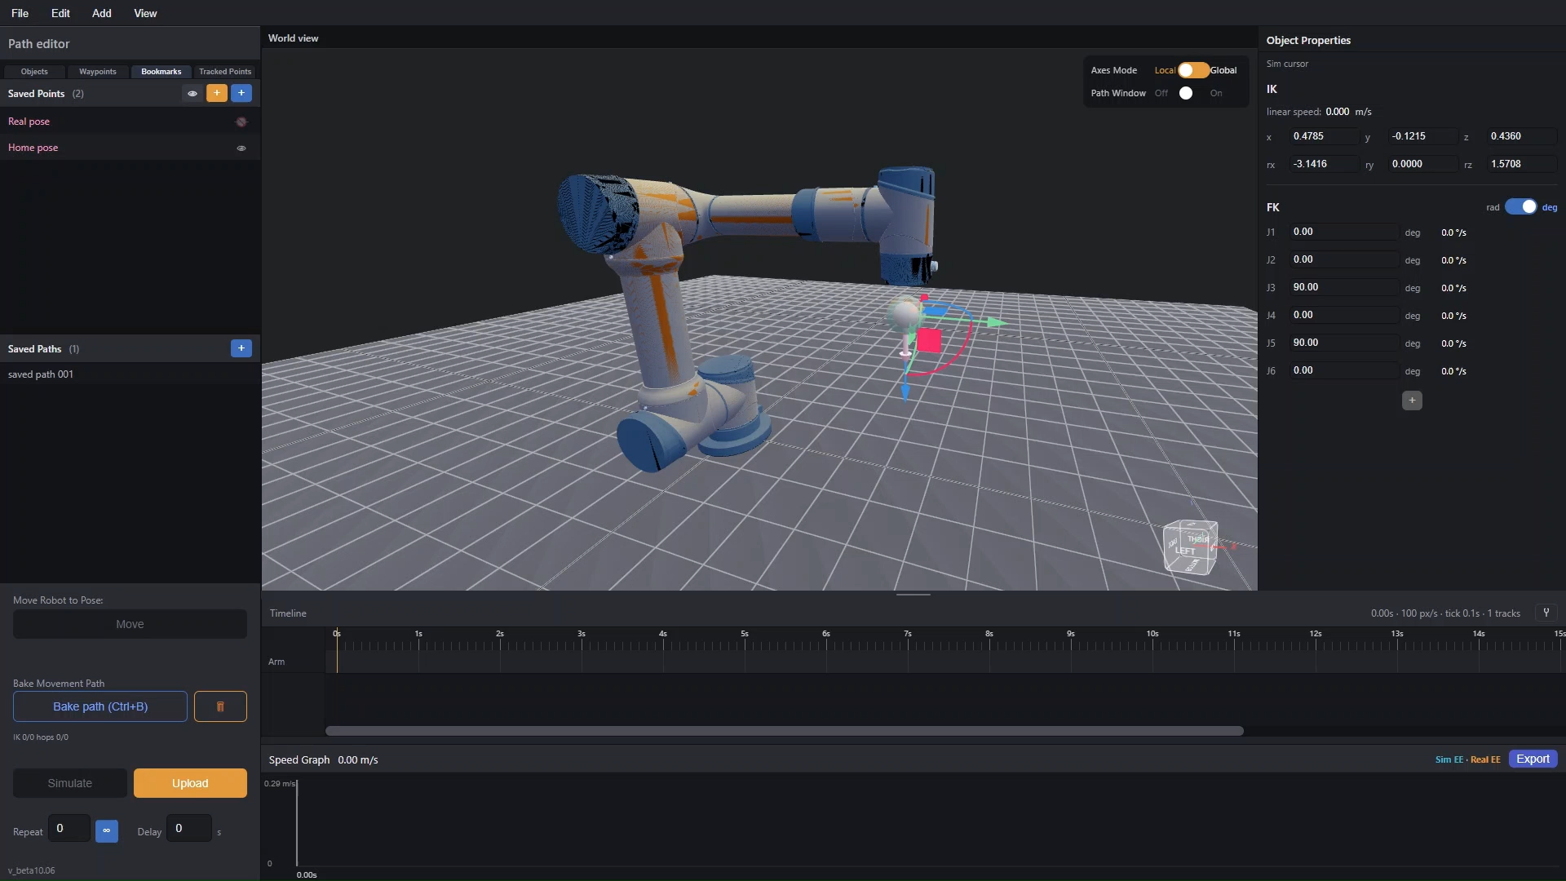


Miscellaneous
File save load function
Autosave and auto back up
Settings menu to edit robot type and joint limits
Auto Reconnection (note: laggy)
Multi camera handling
Hover over saved path to reveal original waypoints

Slide 27
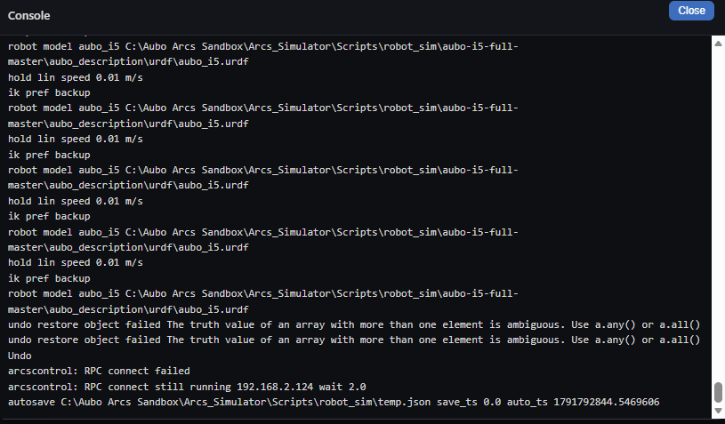
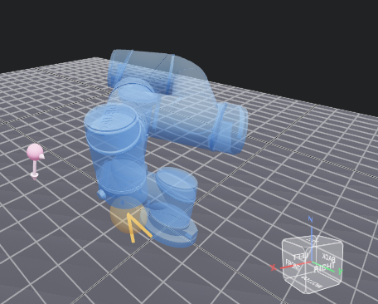



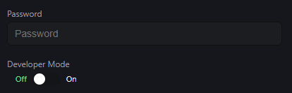
Miscellaneous
View console for debug
Path window to only render a range of waypoints in 3D viewer at a time for simplicity (bugged atm)
View cube to display and control camera view angle (Taken from CAD software)
Radian and degree conversion in most angle related properties
Euler and quaternion conversion in orientation properties
Timeline snap toggle to allow frames to be snapped to grid for simplicity or free placement for fine tuning
Dev mode toggle + pw lock to hide development features

Slide 28
 | 功能 | U-MOCO | Sandbox | 描述 | 实际好处 | Suitability to Transfer to CineBot
1 | 时间线关键帧 | 基础：拖动时长、改路径 | Timeline | 路径点可改时间，前后可交叉并重排 | 同一思路。改一个点的时间不会打乱整条轨迹的顺序规则 | *****
2 | 路径形状与三维预览 | 基础：贝塞尔曲线，三维里看轨迹 | 3D Viewer | 曲线路径画在三维视图里，可看仿真相机视角 | 开拍前能对构图，不必只看关节角 | *****
3 | 现场找点 | 基础：摇杆或手轮开到机位再存点 | Add waypoints | 真实手臂光标: 真实机械臂走到机位，从当前光标落点 模拟光标：在仿真器中移动机械臂以标记位置 | 两种可无缝切换的控制方式，以适应用户在真实或模拟环境中的需求。 | *****
4 | 简单加路径 | 基础：加一段路径做简单控制 | Saved Path | 也可保存、打开自己的路径，或加载出厂示例路径 | 同一条轨迹可换场景再用。 出厂路径用来熟悉软件，不必从空白开始 经验丰富的用户还可以保存自己的路径以便重复使用，甚至针对特定场景进行微调。 | ***
5 | 手扶拖臂示教 | 专业：直接推臂，系统把整段拖动平滑后记下 | Add waypoint from real bot | 只落确认过的点，中间由曲线连接 | 拖臂会把手抖、忽快忽慢和拖的时机写进路径，之后要逐段擦。落点只保留机位，微调一个点不会把整段手势带歪 | Same as pt 3
6 | 速度渐变 | 专业：时间线上拖一条全局速度曲线s | Transition | 每段可选线性，或自定义过渡曲线 | 某一段要慢起或急停，只改这一段，旁边的段不用重画 | **, different implementation on Cinebot since it’s path based instead of point based
7 | 目标锁定 | 专业：锁一个点，臂绕行时镜头保持朝向它 | Tracker | 路径点可绑定场景里的目标，姿态跟着目标 ("Tracker" 部件) | 挪动仿真器中的目标物体，朝向跟着变，不依赖当次认人是否成功 | ****
8 | 画面识别跟随 | 专业宣传的 AI 跟随：认人认物后镜头跟着走 | OpenCV cam | OpenCV 相机可对选定像素用深度相机算出三维点， 用于三维跟踪，也可做拍摄以外的手眼配合 | 可定制的外部脚本，不仅限于识别人脸，还支持将机器人应用于其他场景（例如包裹识别）。目前仍要手动选目标；跟踪物体和这个三维点之间的衔接还在做 | ***

Slide 29
 | 功能 | U-MOCO | sandbox | 描述 | 实际好处 | Suitability to Transfer to CineBot
9 | 运镜中自动对焦 | 专业 | 无 | Sony 自带 |  | Sony camera auto focus (?)
10 | 镜头控制（对焦、光圈、变焦） | 专业：和运镜同一条时间线 | 无 | 套件能点动变焦、设光圈； 软件限制: 这台电脑上厂商通道仍超时 硬件限制：无法物理调节变焦 |  | CineBot may need, sandbox does not have
13 | 虚拟拍摄输出 | 专业：FreeD、帧同步，对接 Unreal 等 | Sim cam | 只有软件里的仿真相机 无引擎输出 |  | Cinebot will use different solution (lower resolution and fps to test run video shoot) instead
14 | 手机看轨迹 | 基础演示：手机 AR 预览运镜 | 无 |  |  | No such plans for Cinebot at the moment
17 | 烘焙调试器 | 不公开 | Baking System | 每段标关节和线速度是否超限，可导出速度记录 | 超速在开拍前能看见，不用等成片抖动再查 用户随后还可以导出运动路径的仿真数据及实际运行数据，以便识别路径中的速度与位置问题。 | Cinebot already has its own baking system
19 | 上传和开跑分开 | 不公开 | Upload | 先传到控制器，传完才走；没传完停止键是灰的 | 软件时钟不会先跑、真臂再追，减少起步那一下跳 | Cinebot already does this
21 | 场景层级 | 以臂和目标为主 | Object Hierarchy | 物体可父子嵌套，局部/全局坐标，仿真光标可当父级 | 允许在机器人上加装其他组件和物体，以执行更多种类的任务 | Useful for sandbox, useless on Cinebot
22 | 多相机 | 未作为分屏物体公开 | Multi Camera | 仿真、电脑摄像头、索尼分类型；左右分屏；每台自己的录制轨道 | 哪一台在录、从哪一秒到哪一秒，写在时间线上。该机器人能够利用多种不同类型的摄像头执行更广泛的任务，而不仅仅是进行视频拍摄。 | Cinebot priority is single camera video shooting at the moment

